Slide 1
Munging CSV data in IPython & pandas
github.com/christopher-jenkins/pandas-examples

Slide 2
IPython / pandas basics
NumPy.Array: MATLAB-like arrays with fast mathematical operations.
Pandas.DataFrame: extends numpy.array to provide much better support for labeling & indexing data tables, combining and slicing subsets of data, etc.
IPython: REPL-like environment with support for GUIs & distributed processing
…IPython Notebook: snazzy browser-based interface for Ipython; code navigation, visual enhancements for data output, sharing and presenting code snippets

Slide 3
IPython / pandas basics
Scientific python distributions (IPython, NumPy, SciPy, pandas…)
Standard Python, pip installers
Python(x,y), WinPython
Canopy (Enthought)
Anaconda (Continuum Analytics): https://store.continuum.io/cshop/anaconda/

Slide 4
Data: rhythm tasks
github.com/christopher-jenkins/pandas-examples

Slide 5
Isochronous serial interval production (ISIP)
Performers attempt to keep a steady, equal-interval beat at a given tempo
Variability in interval durations (time between taps) across the task is analyzed as a means of modeling the cognitive mechanisms behind movement timing

Slide 6
Example: “Wing-Kristofferson model”
Central “clock”
250ms
500ms
750ms
1000ms
Peripheral errors
Performance
long
short
long
Negative lag-1 autocorrelation reflects a peripheral cause of error (e.g., motor control), rather than errors in a central timekeeping process

Slide 7
Individual differences in ISIP
Short-term variability vs. long-term drift
Previous research: Raven’s Progressive Matrices test (brief IQ proxy)
Drift variability & RPM score:
highest correlation when stimuli = about 500 ms (r = about – 0.4)
Local variability & RPM score:
highest correlation when stimuli = about 800 ms (r = about –0.4)

Slide 8

ISIP task, stimuli at 500 ms
Entrainment period (~40 intervals)
Measurement period (continue for about 1m10s)

Slide 9
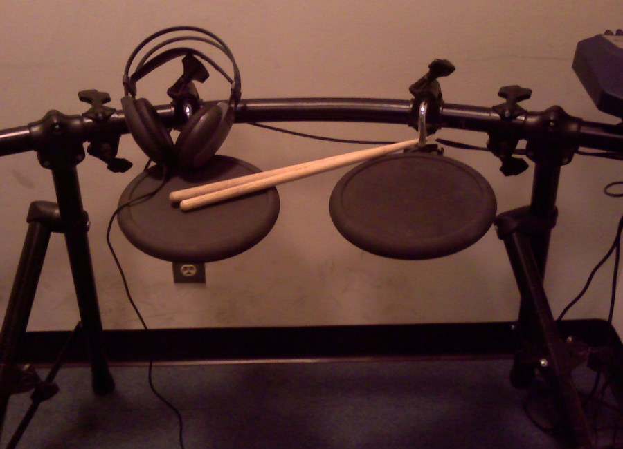
[drum kit photo]

Slide 10
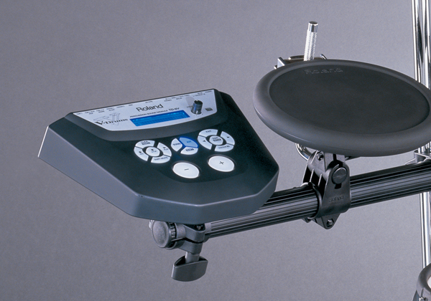
Drums → MIDI → Arduino → CSV

Slide 11
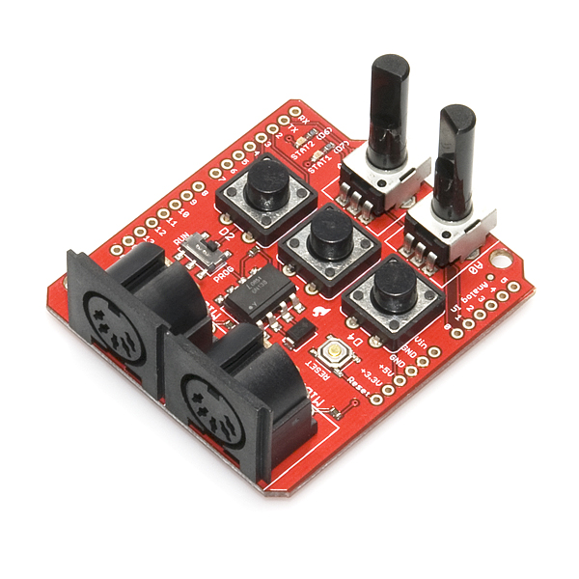
Drums → MIDI → Arduino → CSV

Slide 12
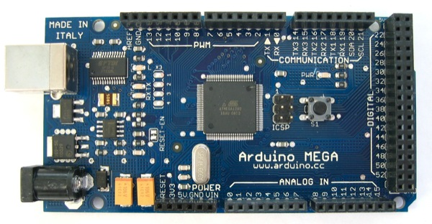
Drums → MIDI → Arduino → CSV
High-resolution timestamps for MIDI input
Slap on some commas
Send as serial text to PC

Slide 13
Working with the resulting data
Collected the data before knowing much about how I’d deal with the CSV files….
Tools being used:
IPython Notebook (2.7)
NumPy, pandas

